Slide 1



FINANCE PRODUCT
Marketing Campaigns
Portuguese Banking Institution 2008~2010
Historical Performance & Future Prediction
Notes:
Good evening Dr. Zhang and class. I’m Wen Xingdi from Group 3. Today, we’ll present our analysis on Marketing Campaigns for a financial product, focusing on historical performance and future predictions. We analyzed marketing data from a Portuguese banking institution to understand the factors influencing term deposit subscriptions.

Slide 2
01.
Problem Statement
State the problem
02.
Introduction
Backgrounds & Data Description
03.
Exploratory Analysis
CONTENTS
Explore the data we have
04.
Pre-Processing
Data pre-processing
05.
Predictive Analysis
Finding & Summary
06
Future Insight
Summary & Future Insight
Notes:
This presentation has six parts:
1. Problem Statement, outlining the key challenges.
2. Introduction, providing background on the data.
3. Exploratory Analysis, where we explore key insights.
4. Pre-processing, explaining data preparation.
5. Predictive Analysis, showcasing model performance.
6. Future Insight, offering business recommendations.

Slide 3
PART 01
Problem Statement
Personnel Business Recruitment Talents raining Elite Management Training TemplaRecruiTraining anagening Template
Notes:
The challenge was to predict whether a client would subscribe to a term deposit based on marketing data. The data, collected from 2008 to 2010, included phone-based campaigns, where multiple contacts were often required to determine if a customer would subscribe.

Slide 4



Problem Statement
Performance Marketing Campaigns of a Portuguese Banking Institution
The data is related with direct marketing campaigns of a Portuguese banking institution. The marketing campaigns were based on phone calls. Often, more than one contact to the same client was required, in order to access if the product (bank term deposit) would be ('yes') or not ('no') subscribed. Year of data is from 2008-2010.
Supply-Side Analysis
Demand-Side Analysis
Government Policy
Market Competition
Production Capacity
Economic Factors
Market Segmentation
Substitute product
Price Sensitivity
Consumer Preferences
Notes:
On the Supply-Side, monetary easing during the financial crisis led to lower interest rates, making term deposits less appealing. They faced competition from safer products like government bonds, cash, and gold.
On the Demand-Side, Economic Factors like fears of financial instability, and Price Sensitivity deterred clients from committing to low-return term deposits. Consumers preferred safer, high-yield assets.

Slide 5
PART 02
Introduction
Personnel Business Recruitment Talents raining Elite Management Training TemplaRecruiTraining anagening Template
Notes:
The dataset covers marketing campaigns from 2008 to 2010, a period influenced by the global financial crisis. These campaigns primarily used phone calls, and often required multiple contacts to assess client interest in subscribing to a term deposit.

Slide 6

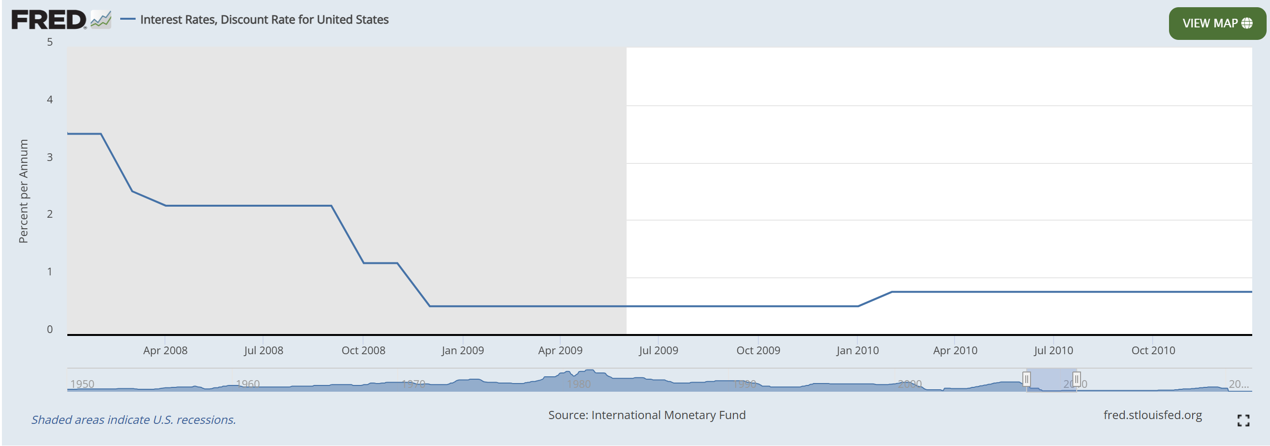
Global Financial Crisis
Notes:
The outbreak of the global financial crisis in 2008, marked by the collapse of Lehman Brothers, triggered huge turmoil in the global economy. Faced with the collapse of the financial system and the sharp fluctuations in the market, the Federal Reserve drastically reduced the discount rate, and central banks around the world took emergency measures to try to stimulate economic recovery through low interest rates. During this period, customers' interest in long-term financial products (such as time deposits) dropped significantly, reflecting the profound impact of economic uncertainty on personal investment choices. This provided an important background for subsequent financial institutions to adjust their products and marketing strategies.

Slide 7
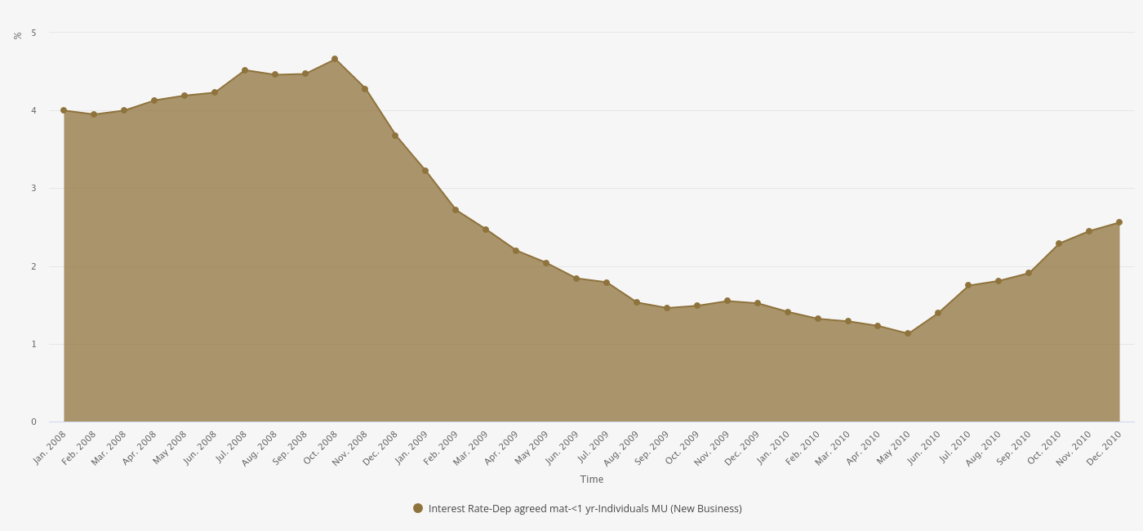
Backgroud
Portuguese Banking Institution 2008~2010
Economic Instability in Portugal
Lower Returns on Deposits
the European Central Bank’s (ECB) monetary easing policies
Lake of confidence to financial institute
More Alternatives to Stable Compounding
Lack of Liquidity Preference
Notes:
In summary, the decline in deposit interest rates, economic instability, and the ECB’s monetary easing policies reduced confidence in term deposits. Consumers were reluctant to lock in funds at low returns, opting for safer assets instead.

Slide 8


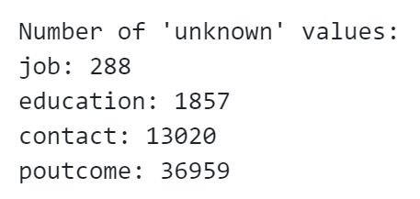
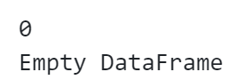
Data Cleaning
Data Cleaning
Usually, data cleaning checks and processes some data that does not conform to common sense and generates data for experiments to prevent changes to the source data. Pre-processing will reprocess the data according to different problems.
Handling Missing Values
Handling “Unknown”
Handling NA
02
Handling Outliers
01
Handling outliers
Outliers' criterion setting individually
Type conversion
03
04
Handling Duplicate
Check whether there is uncommon data types the data type will be changing by needs
There is no duplicate in the dataset.
Notes:
We addressed missing values and inconsistencies. Categorical variables labeled as 'unknown' were replaced with more meaningful categories, like 'other' for job and education, and 'Not Previously Recorded (NPR)' for “poutcome”. No duplicate rows were found, and numeric features were checked for extreme outliers, ensuring a clean dataset for modeling.

Slide 9
PART 03
Exploratory Analysis
Personnel Business Recruitment Talents raining Elite Management Training TemplaRecruiTraining anagening Template

Slide 10
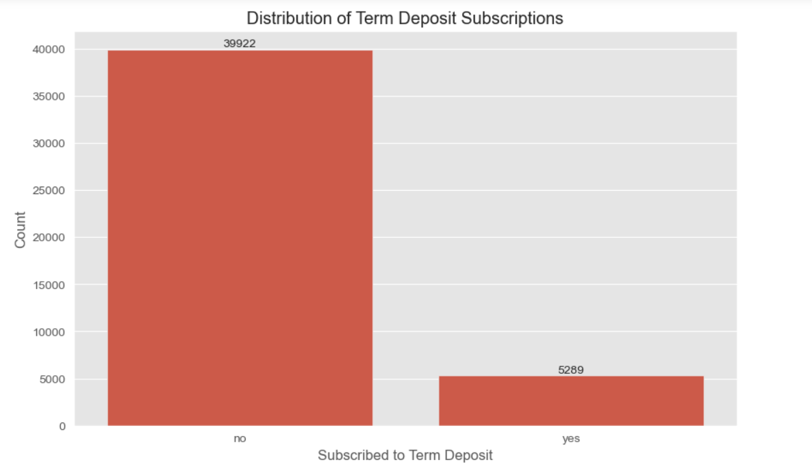
Exploratory Analysis
Distribution of Term Deposit Subscriptions
It is the distribution of y.
Only about 13% people subscribed.
Notes:
First we examined the distribution of term deposit subscriptions, it can be observed that the majority of people have not subscribed. Subscribers account for only about 13%.

Slide 11
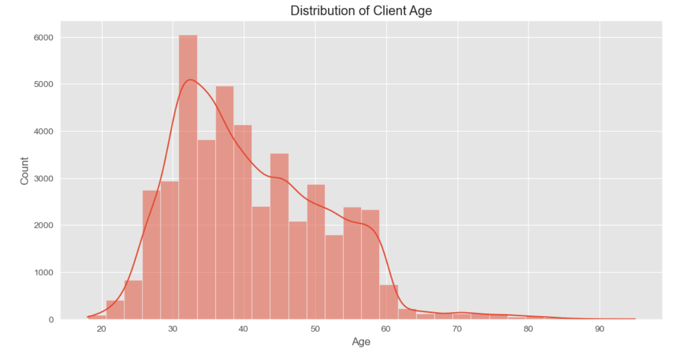
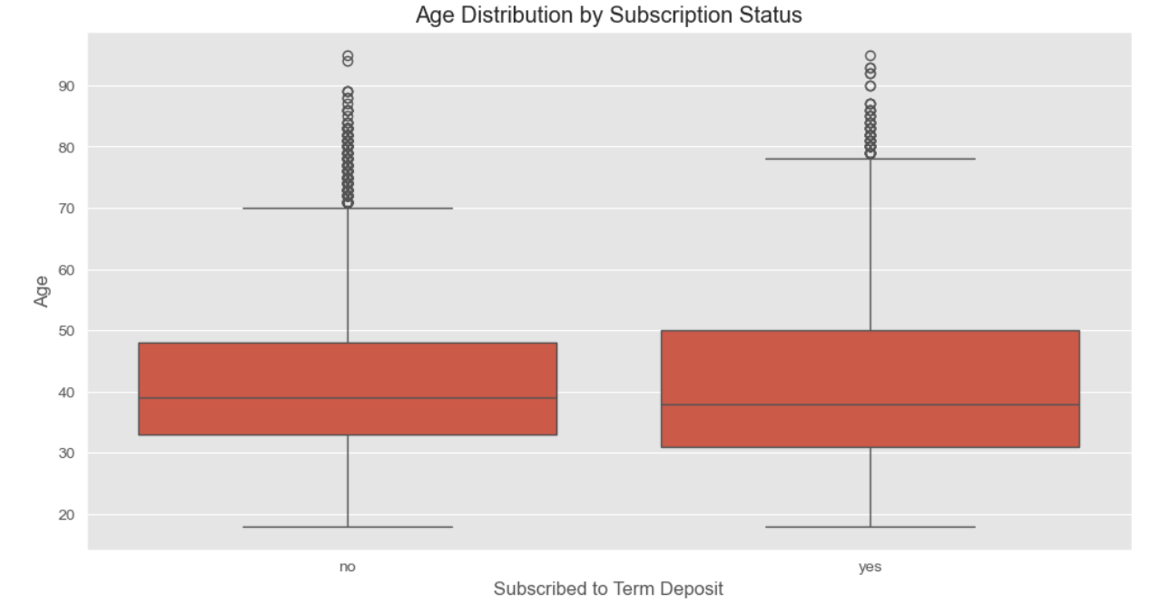
Exploratory Analysis
Distribution of Client Age
The majority of customers are aged between 30 and 60.
The median age of the customers in the two subscribe condition is around 40.
金融股票基金
单击此处编辑您要的内容，建议您在展示时采用微软雅黑字体，本模版所有图形线条及其相应素材均可自由编辑、改色、替换。更多使用说明和作品请详阅模版最末的使用手册。单击此处编辑您要的内容，建议您在展示时采用微软雅黑字体。
单击此处编辑您要的内容，建议您在展示时采用微软雅黑字体，本模版所有图形线条及其相应素材均可自由编辑、改色、替换。更多使用说明和作品请详阅模版最末的使用手册。单击此处编辑您要的内容，建议您在展示时采用微软雅黑字体。
Notes:
Then, we hope to check the status and features that all the clients have individually. we examined the distribution of customer ages and found that the majority of customers are aged between 30 and 60. Also, we checked the Age Distribution by Subscription Status, the median values of each status are around 40. And age does not have a significant impact on the subscription status.

Slide 12
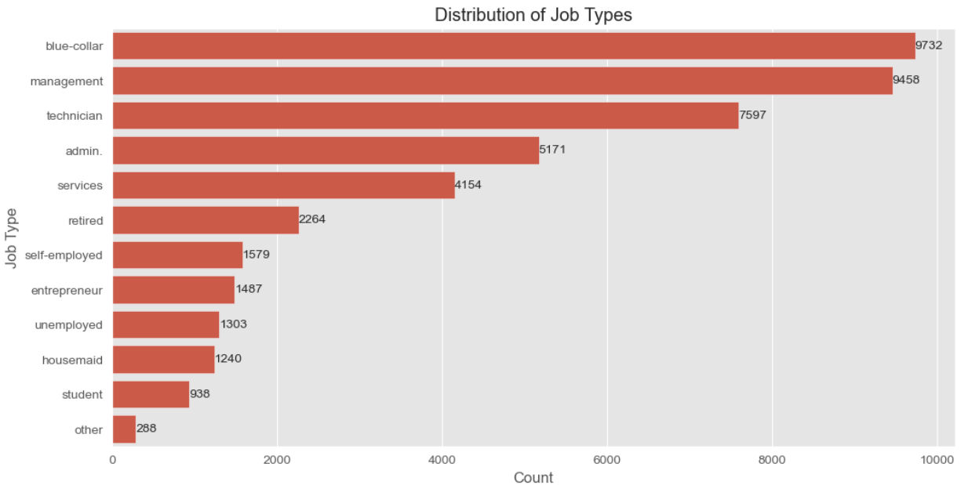
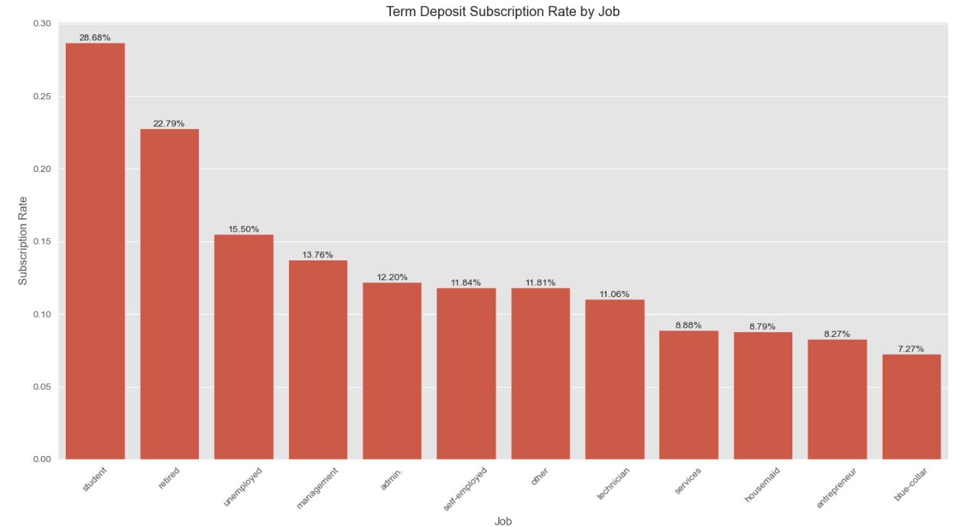
Exploratory Analysis
实际
计划
230
240.6
万
万
The main occupations of the customers are blue-collar, management, and technician, mostly belonging to the middle class.
Students and retirees have the highest subscription rates.
Notes:
Then, we checked the distribution of job types. The main occupations of the customers are blue-collar, management, and technician, mostly belonging to the middle class. We also segmented the subscription rate by occupation, and found that students and retirees have the highest subscription rates. Surprisingly, the middle-class group, which constitutes a large portion of the customer occupations observed earlier, shows lower subscription willingness.

Slide 13
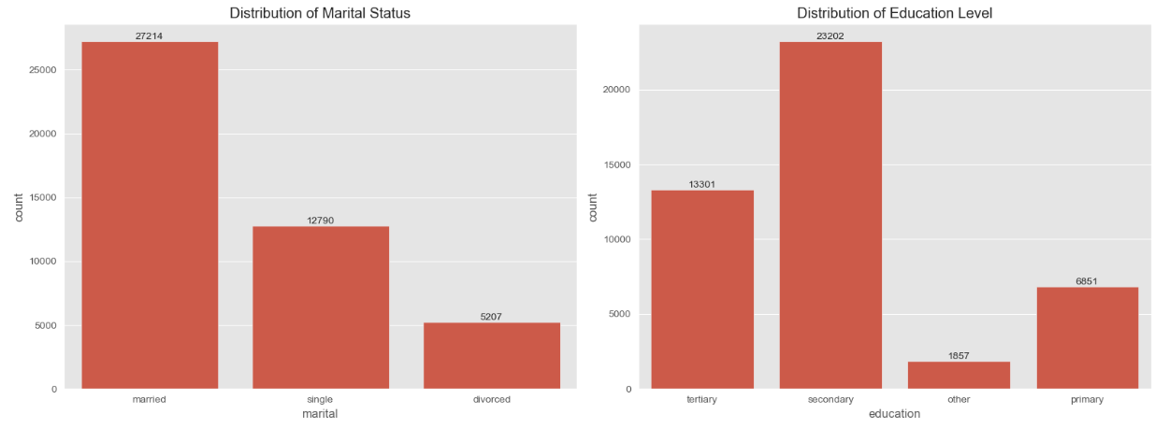
Exploratory Analysis
Among the customers, married people and people who finished secondary school make up the largest proportion respectively.
Notes:
Among the customers, married people and people who finished secondary school make up the largest proportion respectively.

Slide 14
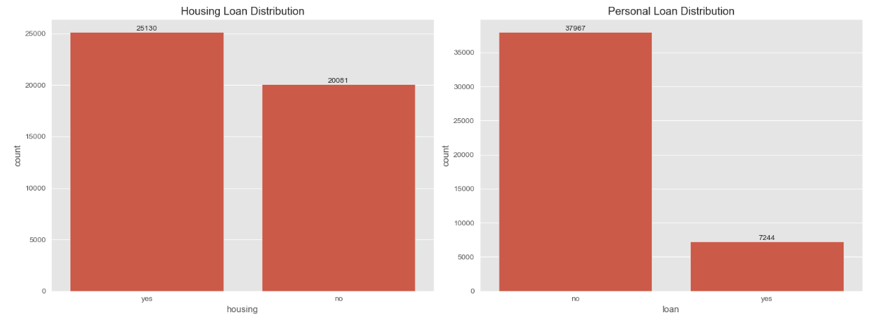
Exploratory Analysis
Housing Loan
Personal Loan
The number of people with a housing loan and without a housing loan is similar.
The majority of people do not have a personal loan.
Notes:
Next, we will check financial situation of the clients. First is whether the clients have loan. The number of people with a housing loan and without a housing loan is similar, and the majority of people do not have a personal loan.

Slide 15
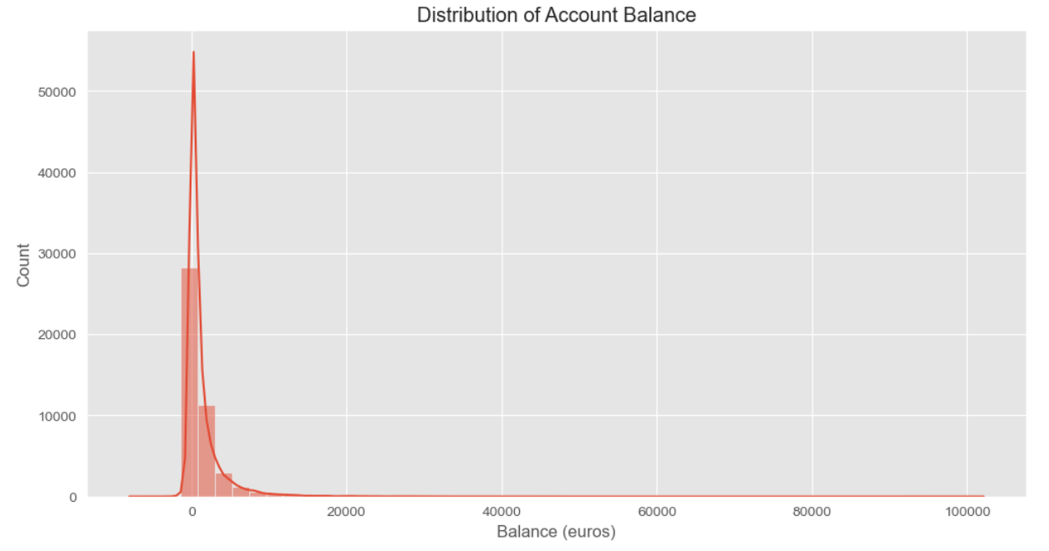
Exploratory Analysis
Most people have relatively low account balances.
Notes:
We also analyzed Distribution of Account Balance. Most people have relatively low account balances.

Slide 16
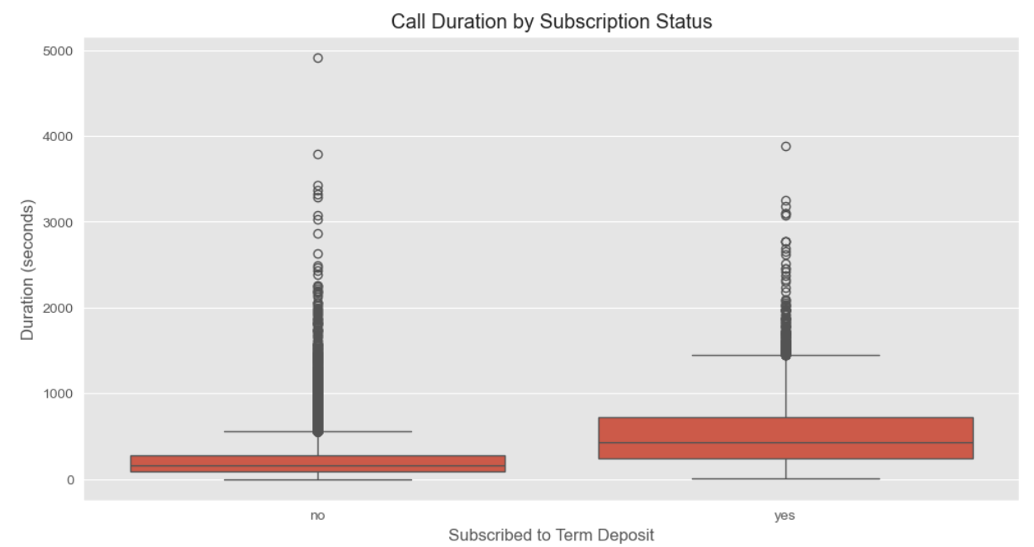
Exploratory Analysis
People who subscribe are more willing to talk through phone.
Notes:
Then, since the bank will get in touch with clients by calling, we also analyzed call distribution. The box plot shows call duration distribution by subscription status. By observing the impact of call duration on subscription status, we notice that those who subscribed to the service have a higher median call duration.

Slide 17
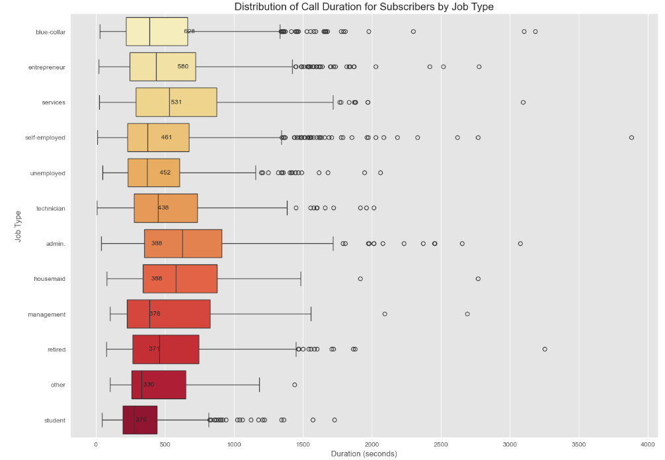
Exploratory Analysis
Among the customers who subscribed to the service, working customers have longer call durations compared to retired customers and students.
Notes:
Among the customers who subscribed to the service, working customers have longer call durations compared to retired customers and students. Additionally, the call duration distribution of working customers is more scattered.

Slide 18
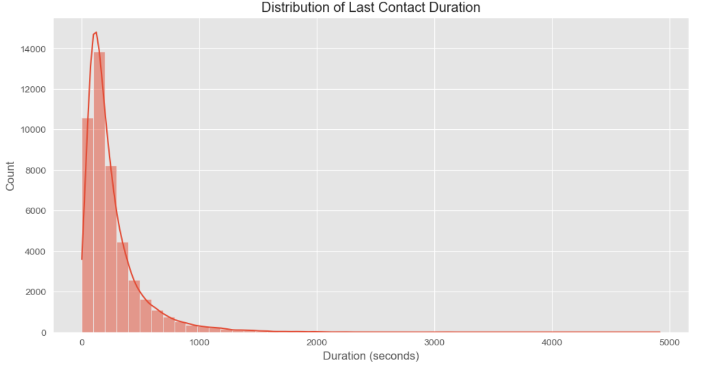
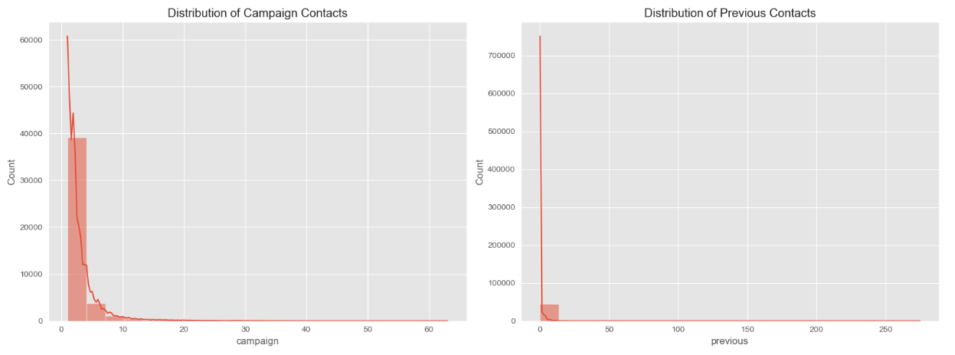
Exploratory Analysis
代理保
By observing the Distribution of Last Contact Duration, the distributions of Campaign Contacts and Previous Contacts, it is evident that most people are unwilling to spend a significant amount of time on calls.
Notes:
By observing the Distribution of Last Contact Duration, the distributions of Campaign Contacts and Previous Contacts, it is evident that most people are unwilling to spend a significant amount of time on calls.

Slide 19
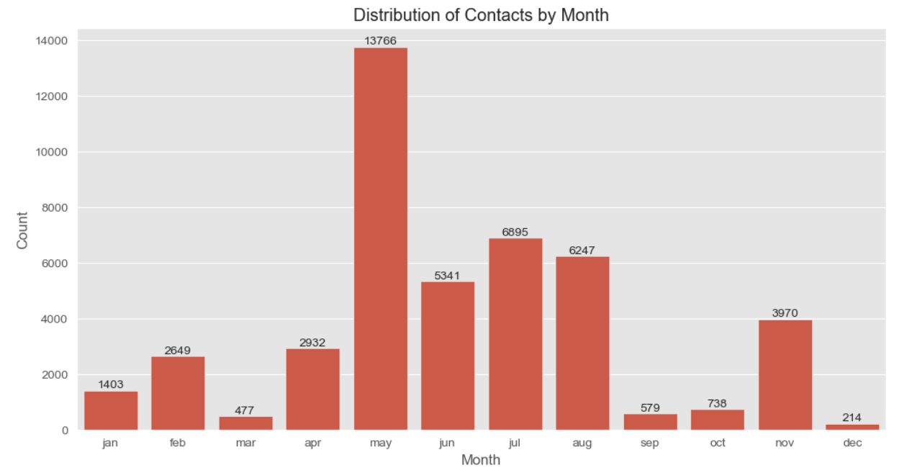
Exploratory Analysis
代理保
By observing the Distribution of Contacts by Month, most contacts are concentrated in May, June, July, and August, which are summer months.
Notes:
By observing the Distribution of Contacts by Month, most contacts are concentrated in May, June, July, and August, which are summer months.

Slide 20
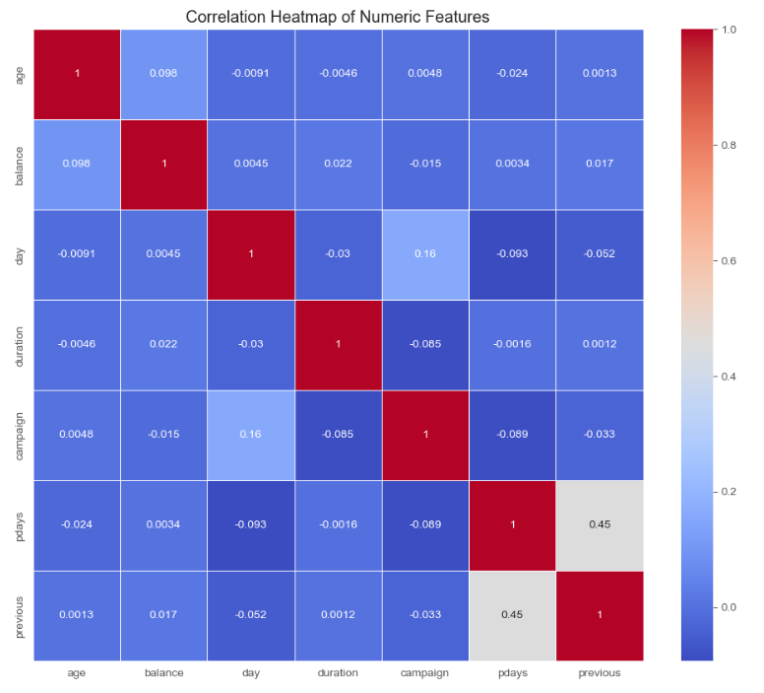
Exploratory Analysis
01
Most of the features are not highly correlated with each other.
02
Relationship between pdays and previous is close.
管理
03
Relationship between campaign and day is close.
Notes:
By observing the heat map, we find most of the features are not highly correlated with each other. It reduces multicollinearity and makes the model more stable.

Slide 21
Exploratory Analysis
Summary
In summary, the bank's customers mostly consist of married middle-class individuals aged between 30-60. There are fewer entrepreneurs, unemployed individuals, self-employed individuals, retirees, and students. Account balances are not very high, and most people are not willing to spend a significant amount of time on calls. Moreover, apart from students and retirees, the subscription willingness of other customers is not high. The time of contact with customers mainly falls in the summer months.
Notes:
In summary, the bank's customers mostly consist of married middle-class individuals aged between 30-60. There are fewer entrepreneurs, unemployed individuals, self-employed individuals, retirees, and students. Account balances are not very high, and most people are not willing to spend a significant amount of time on calls. Moreover, apart from students and retirees, the subscription willingness of other customers is not high. The time of contact with customers mainly falls in the summer months.

Slide 22
PART 04
Pre-Processing
Personnel Business Recruitment Talents raining Elite Management Training TemplaRecruiTraining anagening Template
Notes:
Hello,everyone, I am ZHONG HAO. I will talk about how do we do the pre-processing and predictive analysis in the next sildes.

Slide 23
Pre-Processing
Data Segmentation
Data Encoding
Data segmentation is the process of dividing a dataset into different subsets, which is usually used for training and evaluating machine learning models.
Data encoding is the process of converting non-numeric features (such as categorical variables) into numeric values ​​so that the model can process them.
Feature Engineering
Data Sampling
Feature engineering is the process of extracting or creating new, more representative features from raw data to improve the performance of the model.
Data balancing is the process of dealing with class imbalance in a dataset, especially in classification tasks, to avoid biasing the model towards the majority class.
Notes:
Here are four main processes:
Data Segmentation
Data Encoding
Feature Engineering
Data Sampling

Slide 24
Data Segmentation
Data Segmentation
Objective- Feature Split
Train-Test Split (8:2)
Avoid data leakage:
Ensure that there is no information leakage between the training set and the test set. For example, information from the test set cannot be used during training, which would cause the model to perform better than it actually does during evaluation.
Generalization ability:
The training set is used to build the model, and the test set is used to evaluate the generalization ability of the model.
Preventing overfitting:
Evaluating the model by dividing the test set can help detect and prevent overfitting.
OFS
X contains all feature columns.
y is the target variable (column ‘y’).
TTS
The test set size is 20% (test_size=0.2).
Use random_state=42 to ensure reproducible results.
stratify=y ensures that the distribution of the target variable is consistent in the training and test sets.
Notes:
For data segmentation, X contains all feature columns.
y is the target variable (which is column ‘y’).
We splite Training set into 80% and test set size into 20% (test_size=0.2).

Slide 25
Data Encoding
One Hot Encoding
LabelEncoder
UniversalEncoder
One-Hot Encoding: For categorical variables, each categorical value is converted into an independent binary feature.
For example, the "job" column may be converted into multiple features, such as "job_admin.", "job_technician", etc.
Use LabelEncoder to encode the target variable:
Convert 'yes' and 'no' to numeric values ​​(usually 0 and 1).
Encode the entire target variable, the training set target, and the test set target separately.
The UniversalEncoder class automatically encodes different feature types in a dataset:
Categorical features (object or category type) are handled with One-Hot encoding.
Numerical features are processed using normalized scaling.
Notes:
First, One-Hot Encoding transforms categorical values into independent and binary features. For example, the "job" category can be split into "job_admin," "job_technician," and more.
Next, Label Encoding converts target variables like 'yes' and 'no' into numeric values, typically 0 and 1.
However, for a more streamlined approach, the UniversalEncoder automatically handles both categorical and numerical features. It applies One-Hot encoding to categorical data and normalization to numerical data, saving us the hassle of manual encoding and ensuring every feature is processed correctly.

Slide 26
Feature Engineering
marital_houseloan_status
communication_efficiency
contact_efficiency
1
2
3
4
5
6
campaign_efficiency
financial_status:
edu_job_status
Notes:
We created six engineered features to enhance our model's predictions:
The first is Marital_Houseloan_Status
The second is Communication_Efficiency
The third is Contact_Efficiency
The fourth is Campaign_Efficiency
The fifth is Financial_Status
The sixth is Edu_Job_Status

Slide 27
Data Sampling
Over-sampling
Under-sampling
Definition: Increase the number of minority class samples to make it equal to the number of majority class samples.
Advantages: Preserves the complete information of majority class samples and improves the representation of minority classes.
Disadvantages: May cause model overfitting because oversampling causes information duplication by copying minority class samples.
Definition: Reduce the number of majority class samples to make it close to the number of minority class samples, thereby balancing the dataset.
Advantages: It can reduce the amount of data and reduce the training time of the model.
Disadvantages: It may lose useful information of the majority class, resulting in a decrease in the generalization ability of the model.
SMOTE
The main function of the SMOTE oversampling method is to increase the number of minority class samples in the data set by synthesizing them to achieve sample balance.The core parameters of SMOTE are sampling_strategy and k_neighbors, which control how many minority class samples are generated and from how many neighbors these samples are generated, respectively. random_state is used to reproduce the results, and n_jobs determines the ability of parallel processing.
Notes:
For the data sampling ,We choose oversampling and we try smote on each fold in default parameter.

Slide 28
PART 05
Predictive Analysis
Personnel Business Recruitment Talents raining Elite Management Training TemplaRecruiTraining anagening Template
Notes:
We use the grid search for all the models to do the parameter tuning and automatically try random seeds from 1-10 to find the best seed. Avoid accidental.

Slide 29
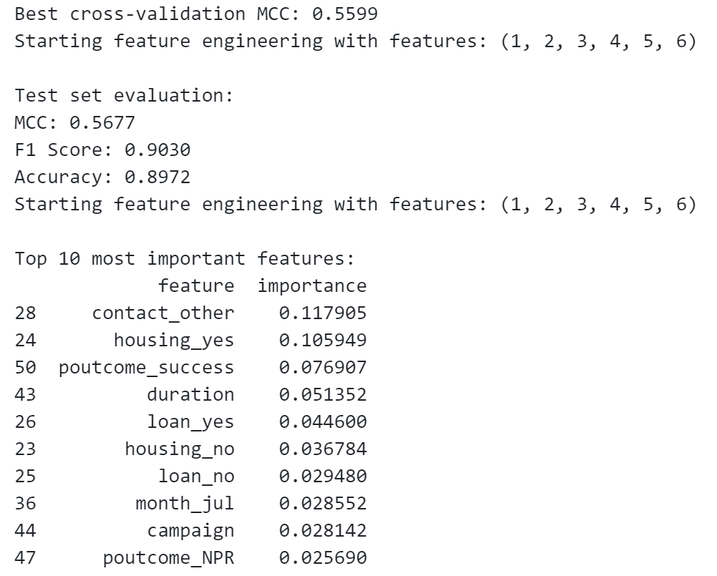
Gradient Boosting Machine
Gradient Boosting Machine
Best cross-validation MCC: 0.5599
Test set MCC: 0.5677
F1 Score:0.903
Accuracy:0.8972
F1 Score and Accuracy are very high, especially F1 Score up to 0.903.
Notes:
We did try GBM. The best cross-validation MCC (0.5599) was achieved after applying SMOTE during each fold, while the test set MCC (0.5677) was calculated without SMOTE. This indicates the model performs well with imbalanced data but can still be improved. Additionally, both F1 Score (up to 0.903) and Accuracy are very high, showing the model’s predictive capacity.

Slide 30
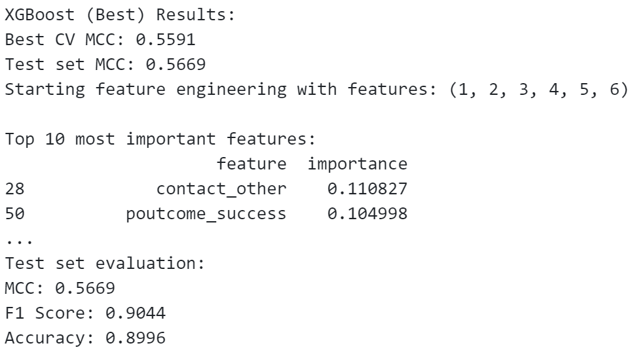
XGboost
XGboost performance：
Best cross-validation MCC: 0.5591
Test set MCC: 0.5669
F1 Score:0.9044
Accuracy:0.8996
F1 Score and Accuracy are very high, especially F1 Score up to 0.9044.
Notes:
XGBoost improves upon the original GBM, boosting both performance and efficiency. So, it performed better.

Slide 31
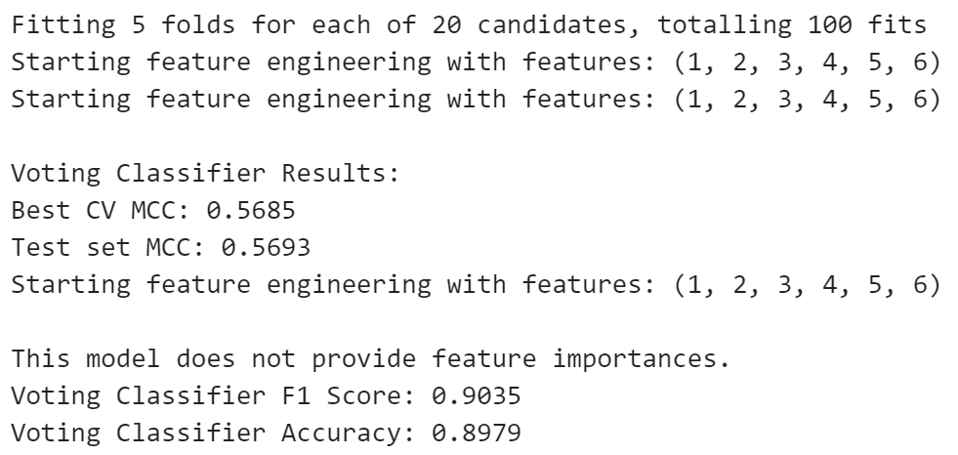
Voted LogisticRegression
Voted Logistic Regression
Best cross-validation MCC: 0.5685
Test set MCC: 0.5693
F1 Score:0.9035
Accuracy:0.8979
F1 Score and Accuracy are very high, especially F1 Score up to 0.9035.
Notes:
VLR also performed well.
A high F1 score alone means the model is good at predicting the positive class, but a lower MCC reveals poorer performance with other classes, especially the negative class. This might be due to factors like SMOTE increasing false positives, or the model overfitting the minority class, which leads to misclassifying majority class.

Slide 32
Predictive Analysis
Better Performance Model at handling imbalanced data
Gradient boosting models
Voted Logistic Regression
they already have strong processing capabilities on unbalanced data and can adaptively focus on minority class samples. After applying SMOTE, synthetic samples may introduce noise or change data distribution, which will affect the performance of these models.
the learning ability of minority classes on unbalanced data is limited. After balancing the data, the number of minority class samples is increased, so that the model can learn the characteristics of minority classes more comprehensively and improve the prediction performance of minority classes.
Summary
Therefore, the performance difference of the model on balanced data and unbalanced data mainly depends on the algorithm characteristics of the model, its sensitivity to synthetic samples, the complexity of the model, and its adaptability to changes in data distribution.
Notes:
Gradient boosting and logistic regression models already handle imbalanced data well by focusing on minority class samples. Finally, we tend to believe MCC because it measures classification problem more comprehensively.Ok, I will pass my mic to my teammate.

Slide 33
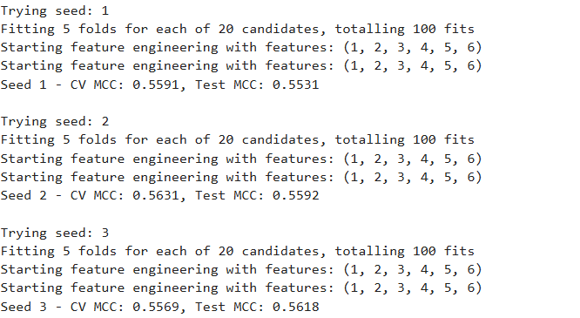
Random Forest
Random forest (seed=2) obtains the test MCC= 0.5592. After smote data balance, the best MCC = 0.5631
Notes:
Best Random Forest Model (Seed 2):
Cross-validation MCC: 0.5631
Test MCC: 0.5592
F1 Score: 0.8897 (very strong precision-recall balance)
Accuracy: 0.8776 (around 87.8% accuracy on the test set)
Feature Importance:
Duration is still the most influential feature, similar to the Decision Tree model.
Other top features include:
poutcome_success: whether the outcome of a previous campaign was successful.
housing_yes and housing_no: whether the individual has a housing loan.
contact_other: type of contact method.
campaign_efficiency and communication_efficiency: seem to relate to campaign or communication performance.

Slide 34
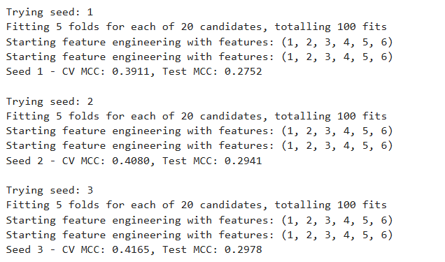
Decision Tree
Decision Tree obtains the test MCC= 0.2978. After smote data balance, the best MCC = 0.4165

Slide 35
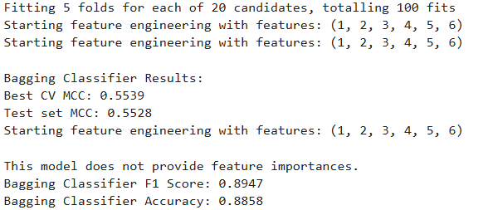
Bagging Decision Tree
Bagging Decision Tree obtains the test MCC= 0.5528, best MCC = 0.5539
Notes:
Best CV MCC: 0.5539
Test MCC: 0.5528 (comparable to Random Forest but slightly lower, indicating similar model performance in handling class imbalance.)
F1 Score: 0.8947 (slightly higher than Random Forest's 0.8897, meaning good precision-recall balance)
Accuracy: 0.8858 (slightly higher than Random Forest's 0.8776, The Bagging model slightly outperforms Random Forest in F1 Score and accuracy, indicating it might handle the precision and recall trade-off more effectively.)
Bagging classifiers do not typically provide feature importance directly, unlike Random Forests or Decision Trees. This is due to the fact that Bagging is an ensemble method that averages predictions from multiple base estimators, often masking individual feature contributions.

Slide 36
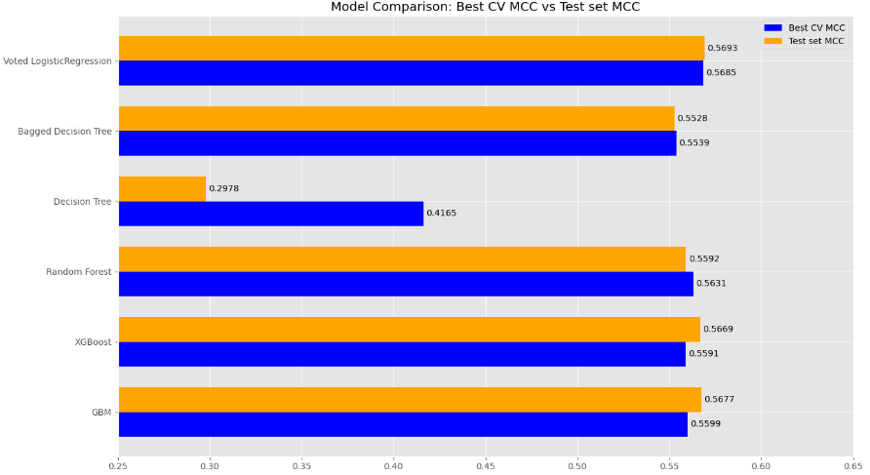
Model Comparision
Ensemble methods outperform the simpler model
The top-performing show very close performance in terms of MCC
Notes:
The bar chart provided compares several models based on their Best CV MCC (in blue) and Test set MCC (in orange).
We compare the performance of Voted Logistic Regression, Bagged Decision Tree, Decision Tree, Random Forest, XGBoost, GBM.
Voted Logistic Regression achieves the highest Test MCC (0.5685), which closely matches its Best CV MCC (0.5693). This suggests that it generalizes well from the training set to the test set.
XGBoost and GBM also show strong performance, with Test MCCs around 0.5591 and 0.5599, respectively, and slightly better Cross-Validation MCCs.
Bagged Decision Tree and Random Forest have similar results, with Random Forest showing a slight edge with a Test MCC of 0.5592.
The Decision Tree model has the lowest performance, with a significant gap between its Best CV MCC (0.4165) and Test MCC (0.2978), indicating potential overfitting during training.
General Insights:
Ensemble methods consistently outperform the simpler Decision Tree model across both cross-validation and test sets. This is expected, as ensemble methods like Random Forest, Bagging, and Boosting (e.g., XGBoost, GBM) combine multiple models to reduce variance and improve generalization.
The top-performing models—Voted Logistic Regression, XGBoost, and GBM—show very close performance in terms of MCC, suggesting these models are well-tuned and are generalizing effectively to unseen data. The slight differences in MCC might come down to nuances in the dataset, hyperparameters, or the specific ways these models aggregate predictions.

Slide 37
PART 06
Future Insight
Personnel Business Recruitment Talents raining Elite Management Training TemplaRecruiTraining anagening Template
Personnel Business Recruitment Talents raining Elite Management Training TemplaRecruiTraining anagening Template

Slide 38
Feature Insight
1
Duration
01
2
02
Poutcome
FEATURE
03
Housing Loan
5
3
04
Campaign Efficiency and Communication Efficiency
4
05
Contact Type
Notes:
Duration: This feature is consistently the most important across models. It likely represents the duration of customer interactions (e.g., call length, campaign duration).
Poutcome (previous campaign outcome): The success of prior campaigns also plays a key role.
Housing Loan (housing_yes/housing_no): Whether a customer has a housing loan appears to influence campaign outcomes.
Campaign Efficiency and Communication Efficiency: The effectiveness of past campaigns and the overall communication process are important.
Contact Type (contact_other): The method of contact is a key factor.

Slide 39
Future Insight
customer engagement quality
01
models show a clear relationship between customer attributes and successful outcomes.
previous campaign outcomes
02
The success of prior campaigns also plays a key role.
financial background
03
The housing loan features suggest that understanding customers' financial obligations can help tailor your product offerings.
Focus on Call Center Operations
04
Given that call duration is highly important, optimizing call center operations might directly impact business success.
Notes:
importance of customer engagement quality, previous campaign outcomes, and financial background in predicting campaign success.

Slide 40
Business Sugesstion
Suggestion
customer segmentation
personalized communication
long-term customer engagement
operational efficiency in campaigns and call centers.
+
+
+
Conclusion
Business strategies should prioritize customer segmentation, personalized communication, and long-term customer engagement, while also optimizing operational efficiency in campaigns and call centers.
Notes:
Business Suggestion:
Longer interactions seem to be positively correlated with successful outcomes. Ensure that customer interactions, such as calls or follow-up sessions, are long enough to allow for deeper engagement. You could optimize call handling scripts, offer additional resources, or extend customer interaction times in marketing efforts.
Leverage the historical success of prior campaigns to guide future marketing strategies. Segment customers based on previous interactions and prioritize those who responded well in the past. This could also mean tailoring follow-up campaigns based on whether previous outcomes were successful or not.
Consider using customer financial profiles as a segmenting tool. Customers with housing loans may have a different financial behavior and needs. Tailor product offerings and communication strategies based on their financial situation, potentially focusing on wealth management or insurance products for these groups.
Continue to track and measure the performance of marketing campaigns. Focus on improving the communication channels and methods used for outreach. For instance, if email communication is less effective, investing more in personal calls or digital engagement platforms may yield better results.
Diversify communication strategies. If the data suggests certain contact methods are more effective (e.g., calls over emails), shift focus to that medium. Ensure that marketing efforts are aligned with customer preferences for communication.
Develop more refined customer segmentation strategies. For instance, separate groups by financial product ownership (housing loans, savings accounts) or communication preferences, and personalize campaigns accordingly. This can lead to a more targeted approach, improving conversion rates.
Use the model to identify the most important predictors of high-value customers or successful campaign responses. Once identified, focus marketing resources on the top segments predicted to convert or engage with the campaign. For example, customers with successful previous campaigns and long-duration engagements should be prioritized.
Train call center agents to engage with customers for longer periods, focus on value-adding conversations, and ensure that agents are knowledgeable about products that align with customer needs. Additionally, monitoring call quality, rather than just quantity, can be crucial for improving campaign outcomes.
Analyze seasonal trends in customer behavior. Certain months may be more effective for certain types of campaigns. For example, if responses are better in months like March or October (as seen in the feature importance), plan major marketing pushes or product launches during these months to maximize engagement.
Invest in tools or analytics platforms to track the performance of your campaigns in real-time. Use these insights to make data-driven adjustments to ongoing campaigns, improving their efficiency and impact.
Offer products that are more aligned with your customers' financial standing.
Offer products that are more aligned with your customers' financial standing.

Slide 41
THANK YOU
￥

